Slide 1
Playback Presentation

Slide 2
Table of Contents
KTSession Overview
Overview of Application
CBMS Infrastructure
Technical Architecture
Server Topology
Data flow between Interfaces
Tools and Technologies
Business User/Stakeholders
Challenges and Issues
Environmental Details
Interfaces

Slide 3
KT Session Overview
Application name | CBMS
No. of sessions Planned | 3
No. of session Conducted | 3
Reason for variation (if any) | NA
Topics covered | Business functionality, Interfaces and various components, Technical Architecture & Code/DB walkthrough, Q&A Session
Name of SCB SME/s | Koh, Tat Hai (Chris)
Name of HCL SME/s | Shriram Elangovan, Pradeep Arulmozhi, P Harikrishnan & Pradeep Agarwal
Mode of KT session | Face 2 Face
Name of documents referred during KT | CBMS Interface Data Mapping V0.2.xlsx CBMS Infrastructure Details.pptx

Slide 4
Overview of CBMS
CBMS is a proxy Bureau application for Malaysia developed by SCB.
CBMS gets customer’s information from CTOS, CCRIS and DCHEQ.
CBM is the Credit Bureau for Malaysia maintained by Bank Negara.
The Bureau accesses and maintains both positive and negative credit information in order to provide a more
comprehensive view of an SME’s or Consumer’s credit standing.
The Bureau obtains its credit information from the following data sources :
Central Credit Reference Information System (CCRIS) managed by Bank Negara Malaysia (BNM).
Dishonoured Cheques information (DCHEQS) managed by Bank Negara Malaysia (BNM).
Non-bank Credit Information which is provided and updated by CBM subscribers on a voluntary basis.
CCRIS collects credit-related information on borrowers from lending institutions and furnishes the credit
information collected back to the institutions in the form of a credit report.

Slide 5
Overview of CBMS - continued
CCRIS report will contain credit related information of an individual such as below:
Outstanding credit
Special attention accounts, which are credit facilities under close supervision of financial institutions
Applications for credit in the previous 12 months that have been approved or are pending.
CTOS is Malaysia’s leading private Credit Reporting Agency (CRA) which provide customer’s bureau information
to banks.
CTOS collects credit related information from various public sources such as:
National Registration Department
Malaysia Insolvency Department
Companies Commission Malaysia (CCM)
Publications of legal proceedings and notices in newspapers and government gazettes.
CBMS interfaces with Application Processing (AP) Systems like CRES, SME and APPS.
Two Financial Institution licence are required for conventional & Saadiq Products.

Slide 6
Overview of CBMS - continued
Data is exchanged with CCRIS through secured line via secured gateway servers.
Users prepares (SAS) manual scrub list from PDW data and sends data to CCRIS B2B which in turn sends this
data to CBMS.
CBMS has both online data & scrub list.
Each customer enquiry is stored in CBMS App DB for 3 months.
Data is sent to PDW on a regular basis and is stored in PDW for a period of 10 years.
PDW Server is located in Hongkong.
Scoring is done in a separate component within CBMS server.
Data is sent to Probe on a daily basis whereas it is sent to RLS Scoring on a quarterly basis.

Slide 7
Overview of CBMS - continued
Business Criticality : Medium (3)
CBMS Global Application inventory (GAI) ID is 18530
Project Model: Waterfall
SVN Details:
1. VOB Name - cbmssrv
2. View Name - cbms_r1.0_pd (Production) and cbms_r2.0_dev (Development)
Pipeline Projects:
Regulatory changes - BNM Mac 2017 Enhancement – Malaysia

Slide 8
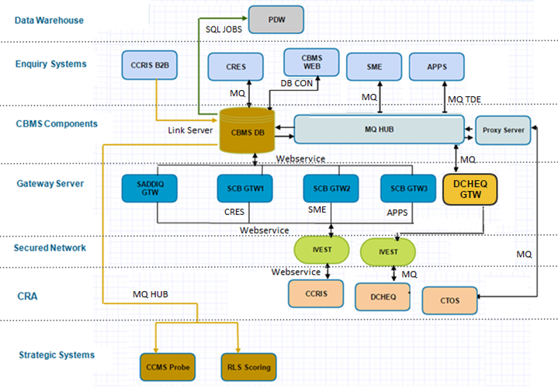
CBMS Infrastructure

Slide 9
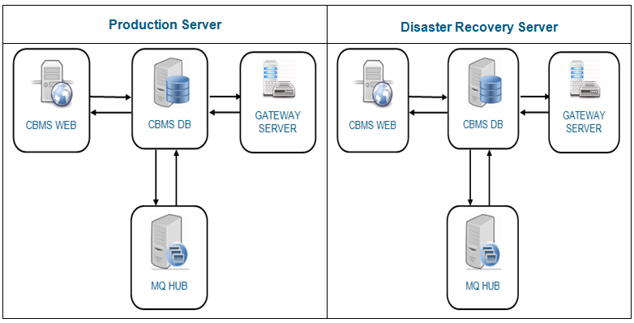
CBMS Server Topology

Slide 10
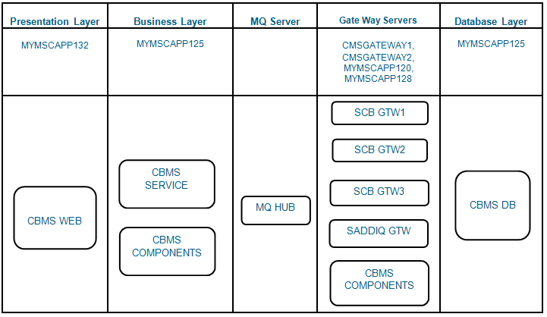
Technical Architecture

Slide 11
Interfaces
CBMS has currently interacting with below interfaces:
CRES - Personal and Mortgage loan origination system for country Malaysia.
SME – Business Loan origination system for Malaysia country of business.
APPS – Credit card origination system for Malaysia.
CCMS PROBE - Interacts with CBMS for Probe calculation
RLS scoring – Interacts with CBMS to get score for Retail Loan system (RLS).
Web Server – Sales team makes the Online Credit Bureau enquiries.
Production Data Warehouse (PDW) – Common data storage for all applications.

Slide 12
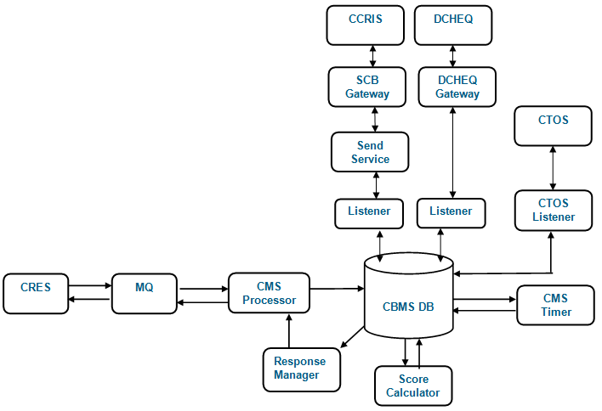
CRES Interface Dataflow

Slide 13
CRES Interface Dataflow - Continued
CRES is a retail loan origination system for Malaysia.
It enquires for Bureau information of customer applying personal and mortgage Loans.
CBMS collects credit bureau information from CTOS, CCRIS and DECHQ CRA’s.
Connections are made to CRA’s via secured Gateway through secured network.
CBMS communicates with CCRIS via Web service through the component called Send Service.
CBMS connects to other CRA’s (CTOS and DECHQ) via MQ.
CRES communications are made to CBMS via MQ online.
CMS Processor pick those enquiry and updated CBMS DB.
Listener converted those enquires from DB to understandable format for Bureau’s.
Formatted enquires are send to CCRIS via Send Service, CTOS via MQ Hub gateway and DECHQ via MQ Send Service.
Response Data are calculated in CBMS DB and Send to CRES via Response Manager.

Slide 14

SME Interface Dataflow

Slide 15
SME Interface Dataflow - continued
SME is a business loan origination system for Malaysia.
SME communicate to CBMS via MQ-Hub online.
CMS Processor pick those enquiry and updated CBMS DB.
Listener converted those enquires from DB to understandable format for Bureau’s.
Formatted enquires are send to CCRIS via Send Service, CTOS via MQ Hub gateway and DECHQ via MQ Send Service.
Response Data are calculated in CBMS DB and Send to SME via Response Manager.

Slide 16
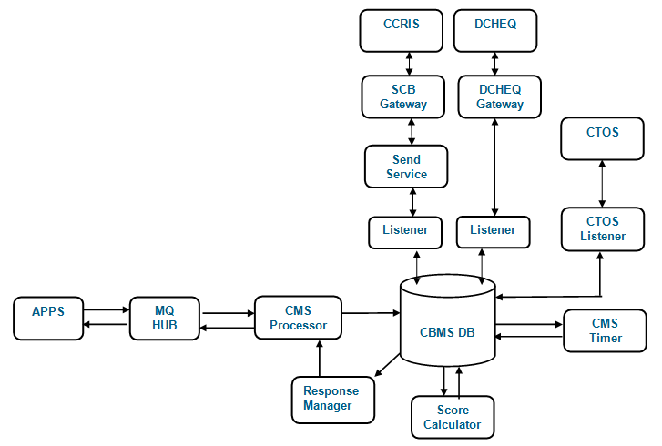
APPS Interface Dataflow

Slide 17
APPS Interface Dataflow - continued
APPS is a credit card origination system for Malaysia.
APPS communicate to CBMS via MQ-Hub batch.
CMS Processor pick those enquiry and updated CBMS DB.
Listener converted those enquires from DB to understandable format for Bureau’s.
Formatted enquires are send to CCRIS via Send Service, CTOS via MQ Hub gateway and DECHQ via MQ Send Service.
Response Data are calculated in CBMS DB and Send to APPS via Response Manager.

Slide 18
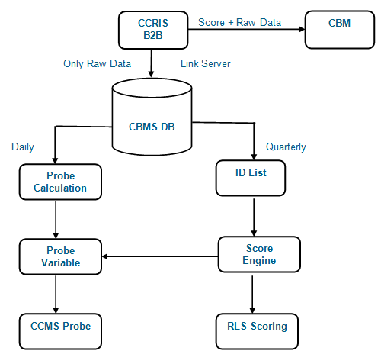
CCMS Probe & RLS interface Dataflow

Slide 19
CCMS Probe & RLS interface Dataflow - continued
CBMS Interface with CCMS Probe and RLS is different compare with the previous transaction.
These interface requires only to calculated Probe and Score details from CBMS.
Due to this CBMS will not connect to Bureau’s for credit bureau information.
Raw data’s are sent from CCRIS B2B to CBMS via linked server.
CBMS send ID List to score engine quarterly to calculate the score to RLS.
CBMS send the daily request to probe calculation component to process probe variable and send it to CCMS Probe.

Slide 20
Environment Details
Environment | Name of Environment | Contact Person for Access/Issue
SIT/UAT/QA | Web & App Server:10.112.177.50 CBMS DB Server:10.112.117.50 MQ-HUB Server: 10.112.117.50 | East Server Team
Production | CBMS Web Server: MYMSCAPP132 CBMS Gateway Servers: CMSGATEWAY1, CMSGATEWAY2, MYMSCAPP120, MYMSCAPP128 CBMS App & DB Server : MYMSCAPP125 MQ-HUB Server: | Production System Support Team(PSS)
There is no dedicated server assigned for SIT/UAT/QA Server.
Based on the requirement/priority, each server can be used for SIT/UAT/QA Server

Slide 21
Database Details
Functionality Name | Table Name
User Profile | User_Profile
Queue Configuration tables | Config_Steps, Config_System
Enquiry table | BCB_NEW_WEB, BCB_Service, BCB_FR_CRIS, BCB_FR_CTOS, BCB_DCHQ , BCB_FR_BLST
Transaction configuration table | Config_TXN_Code
Export Data tables for PDW | PDW_ADD_OnlineExtract, PDW_BLS_OnlineExtract, PDW_CON_OnlineExtract, PDW_DCQ_OnlineExtract, PDW_DRY_OnlineExtract, PDW_MAS_OnlineExtract, PDW_OCC_OnlineExtract, PDW_RAW_OnlineExtract

Slide 22
Tools
Tools required for CBMS:
Tool Name | Purpose | Brief Description
Visual Studio 2012 | IDE | To write code for developing UI, business logics
SQL Server 2008 Management Studio | Database | Backend database for CBMS
Tortoise SVN | Source Control | Source code repository

Slide 23
Pre-requisites S/W
Software | Version
Microsoft Framework | 1.1, 1.2 and 2.0
SQL Server | 2005
IBM WS MQ | 6.0
IIS | 6.0

Slide 24
Key Processes and Procedures
Process Name | Description
Requirement Analysis | Once Business Requirement Document is obtained from Business Analyst after sign off , Tech Lead will Analyse the requirement , Technologies to be implemented , Resources and Estimation for this requirement.
Design | Tech lead will provide Structure of the Project , Stream to deliver the change in Version Control Tool , UML diagram for the given requirement and Statement Of Work on code flow from Presentation tier to Persistence tier.
Construction | After finalizing the requirement and design , developer will start to work on implementing the requirement. Code review will be done by Lead after the development.
Testing | Unit test case will be prepared by the developer that includes testing the modules within the application system. Connectivity testing will be established for the interface system.
Release | Arrange KT to PSS and get the sign off for PSS KT. Prepare the PRA sheet and send it to TSM and get the approval. Send the change list and supporting document to the CAB coordinator. Arrange the walkthrough with implementer , if required. Production DOD needs to raised and get the production binaries. Once the change was submitted, then approvals needs to get from implementer. Change will be presented in the precab and get the precab approval. Once the precab is approval then the change will move to CAB. Change will be present in the CAB and get the approval. Implementer will do deployment according to the AIG. Sanity verification will be done by Dev team. Once the deployment is completed , the Dev team will ask the business user will do the testing. Business user will share the UVT sign off.

Slide 25
History of changes
Project ID | Change | Release Date | Country
BNM CCRIS regulation Enhancement | Regulatory Change | Dec 2016 | Malaysia

Slide 26
Upcoming Release Plan
S.No | Change Request | Status | Tentative Implementation Date | Region
1 | Regulatory changes - BNM Mac 2017 Enhancement. | Requirement Gathering phase | June 2017 | Malaysia

Slide 27
Business Users
Around 166 (user profile including administrator) are exist for CBMS application in Malaysia.
Those user List is available in the attached excel.

Slide 28
Stakeholders
Team | Country | Name | Phone No | Mail Id
CBMS | MY | Tat Hai Koh | +603 7681 3344 | koh.tat-hai@sc.com

Slide 29
Challenges and Issues
Highlight key challenges and issues are known for this application
SN | Key Issues | Current Solution
1 | Usage of SP command shell | Reported as a risk and no solution is currently available.

Slide 30
Q&A

Slide 31
Thank You

